Slide 1
FOR & SINCE
By: Vidisha Kashyap

Slide 2
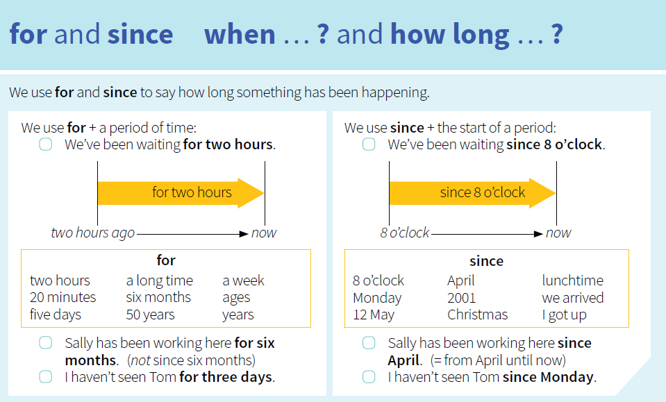

Slide 3
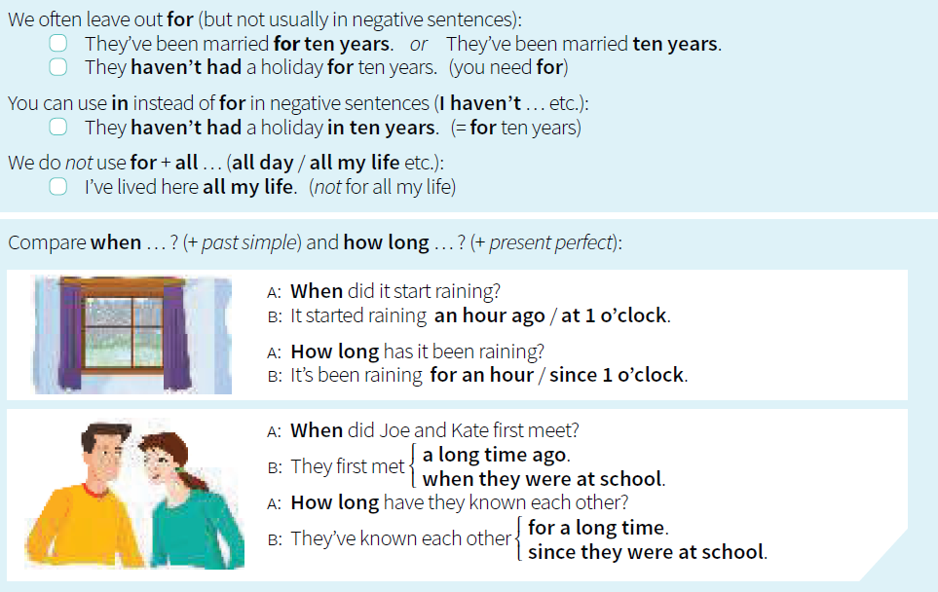

Slide 4
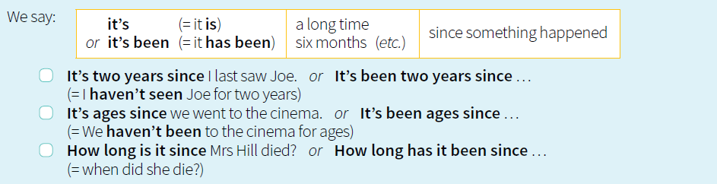

Slide 5
Write for or since.
1 Helen has been in Ireland since Monday.
2 Helen has been in Ireland for three days.
3 My aunt has lived in Australia................................15 years.
4 Tina is in her office. She has been there...............................7 o'clock.
5 India has been an independent country...............................1947.
6 The bus is late. We've been waiting...............................20 minutes.
7 Nobody lives in those houses. They have been empty.................................many years.
8 Michael has been I ll ................................ a long time. He has been in hospital.................................October.

Slide 6


